Slide 1
Are You an Accident of Nature?
Part 2 Free Will and Self Awareness

Slide 2
Are you a robot?

Slide 3
Everything Predetermined?

Slide 4
Thoughts Predetermined?
If Chemistry and Physics
determine everything
All your thoughts were predetermined when universe was created.
You could not control your thoughts.

Slide 5
You would be a robot!

Slide 6
The real you is non physical.
You have a spirit.

Slide 7
Bible
the LORD Who
. . . forms the spirit of a man within him.
Zechariah 12:1

Slide 8
I think.
Therefore I am.
Notes:
Self Awareness
Where does self awareness come from?
It is non-physical.
It comes from your spirit.

Slide 9
I stink.
Therefore I am.
Notes:
We are also aware of others; some are easier to love than others.

Slide 10

Source of Self Awareness?
No Atom is
Self Aware
Putting 2 or More Atoms Together Will Not Make Them Self Aware

Slide 11


Purely physical world cannot explain self awareness
+
=
Notes:
Putting 2 atoms together that do not have self awareness, will not make a self-aware molecule. Self-awareness is a non physical property.

Slide 12
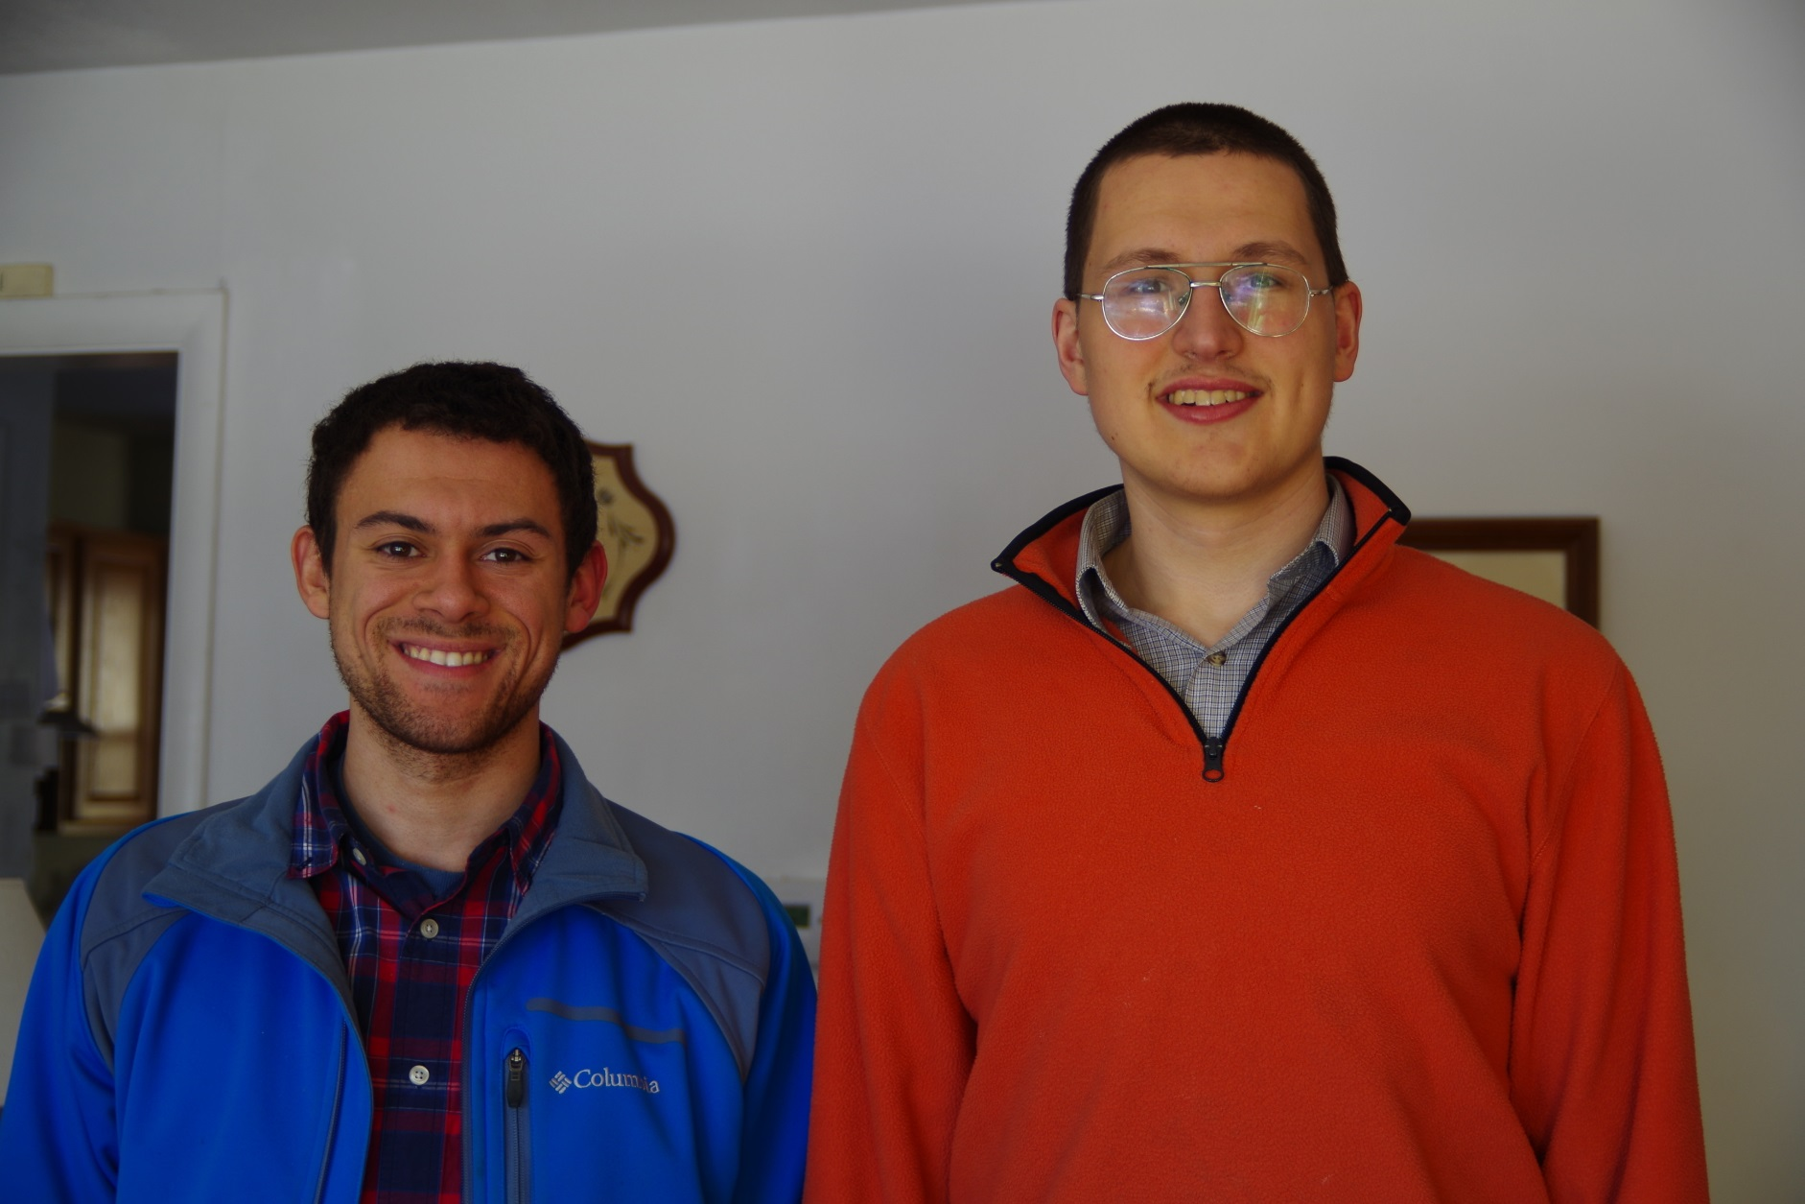
DNA affects:
Height
Hair Color
Notes:
DNA controls things like height and hair color,
but it does not control the real you.

Slide 13
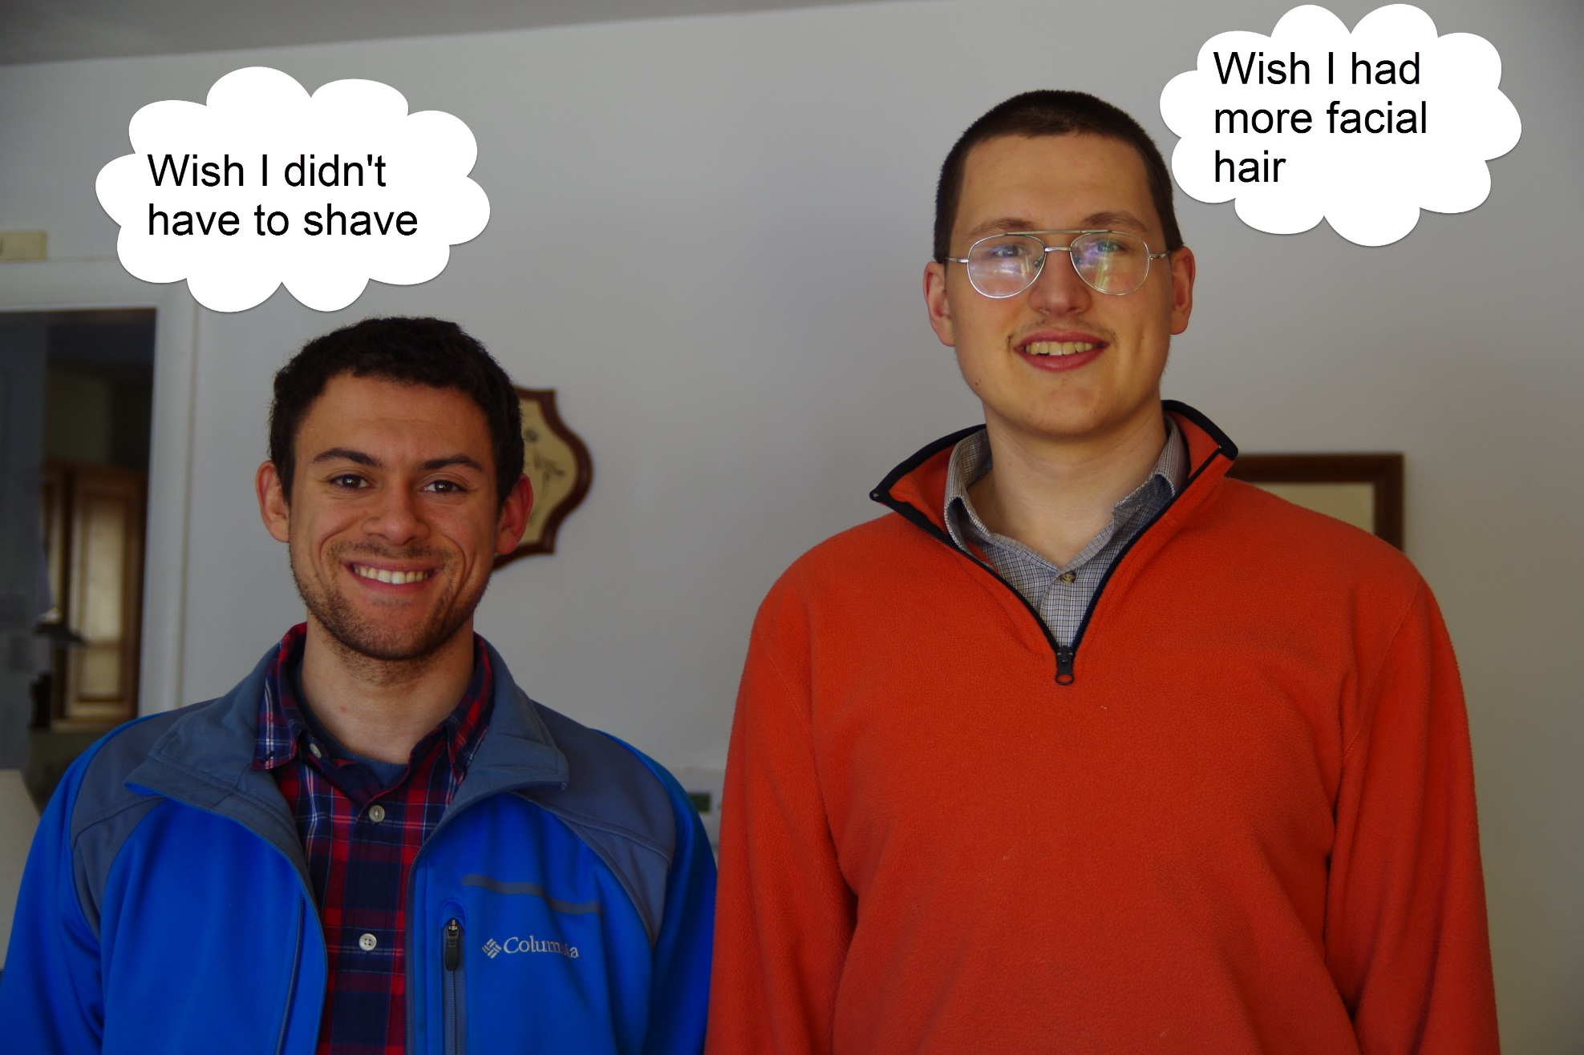
DNA does not control thoughts
Notes:
DNA controls things like height and hair color,
but it does not control the real you.

Slide 14
Spirit gives you
Free will
Self awareness
Aware of others
Ability to love
Moral responsibility
Notes:
Your spirit gives you the freedom to choose. It also makes you self aware. Science can’t explain either your free will or your self awareness. Mere chemicals are not self aware. Your spirit comes from a spiritual God and lives forever. You are a moral being. You are accountable to your Creator.

Slide 15
You are accountable
to your Creator.

Slide 16
God’s Commands
Love God
Love your neighbor as yourself
Be holy,
Completely pure

Slide 17


Righteous
God
Where will I go when I die?
Hell

Slide 18
Give your own presentations.
Free downloads of Powerpoints used in these videos at:
Educate7.com
How7.org
Are You an Accident of Nature?

Slide 19
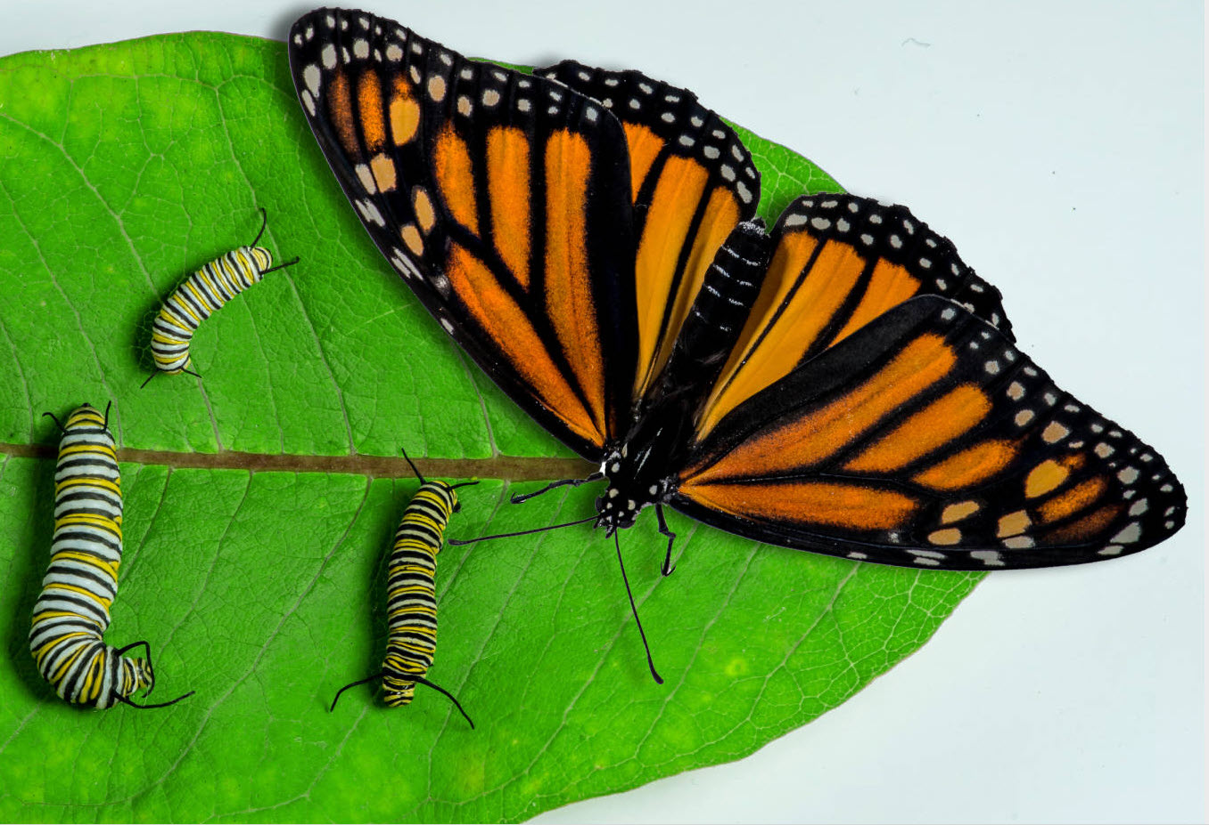
Part 3: Mistakes Evolutionists Make and Common Sense
Next:

